Slide 1
CS440/520 Artificial Intelligence
Computer Science Department
Lecture 6:
Review of Adversarial and Local Search –
Genetic Algorithms -
Constraint Satisfaction Problems
18 September 2014
Instructor: Kostas Bekris

Slide 2
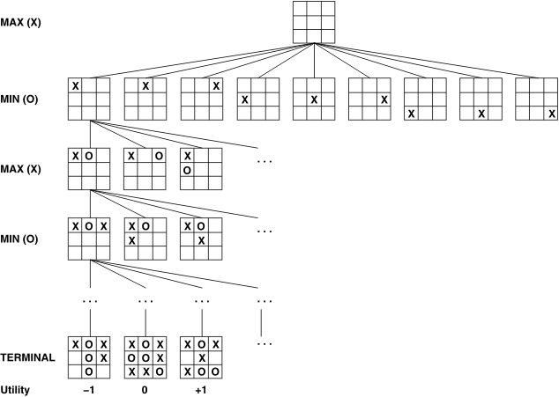
Tic-Tac-Toe

Slide 3
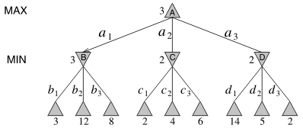
Minimax Algorithm

Slide 4
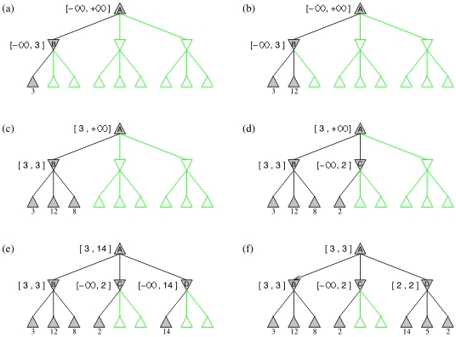
α-β (alpha-beta) pruning

Slide 5
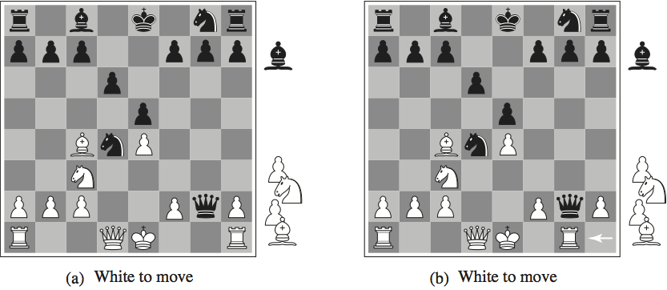
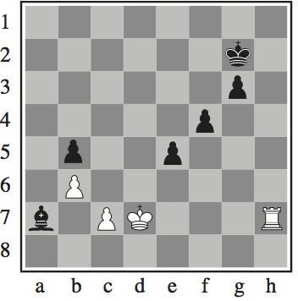
Chess

Slide 6
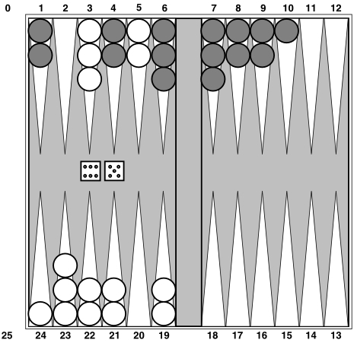
Backgammon

Slide 7
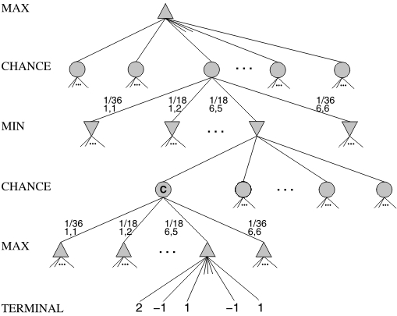
Chance in Games

Slide 8
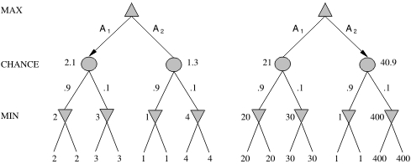
Scaling Issues

Slide 9
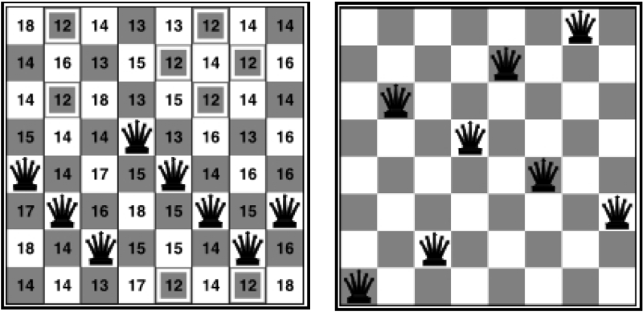
8-queens Example

Slide 10
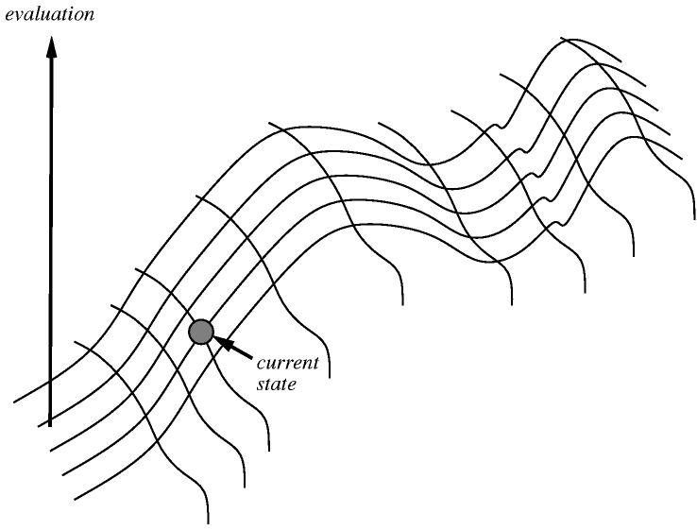
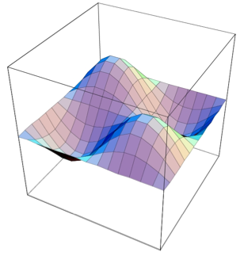
Hill Climbing

Slide 11
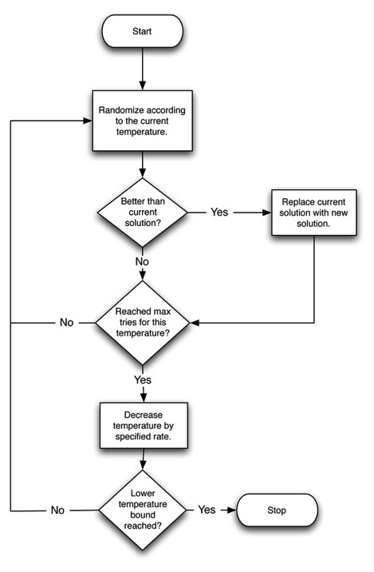
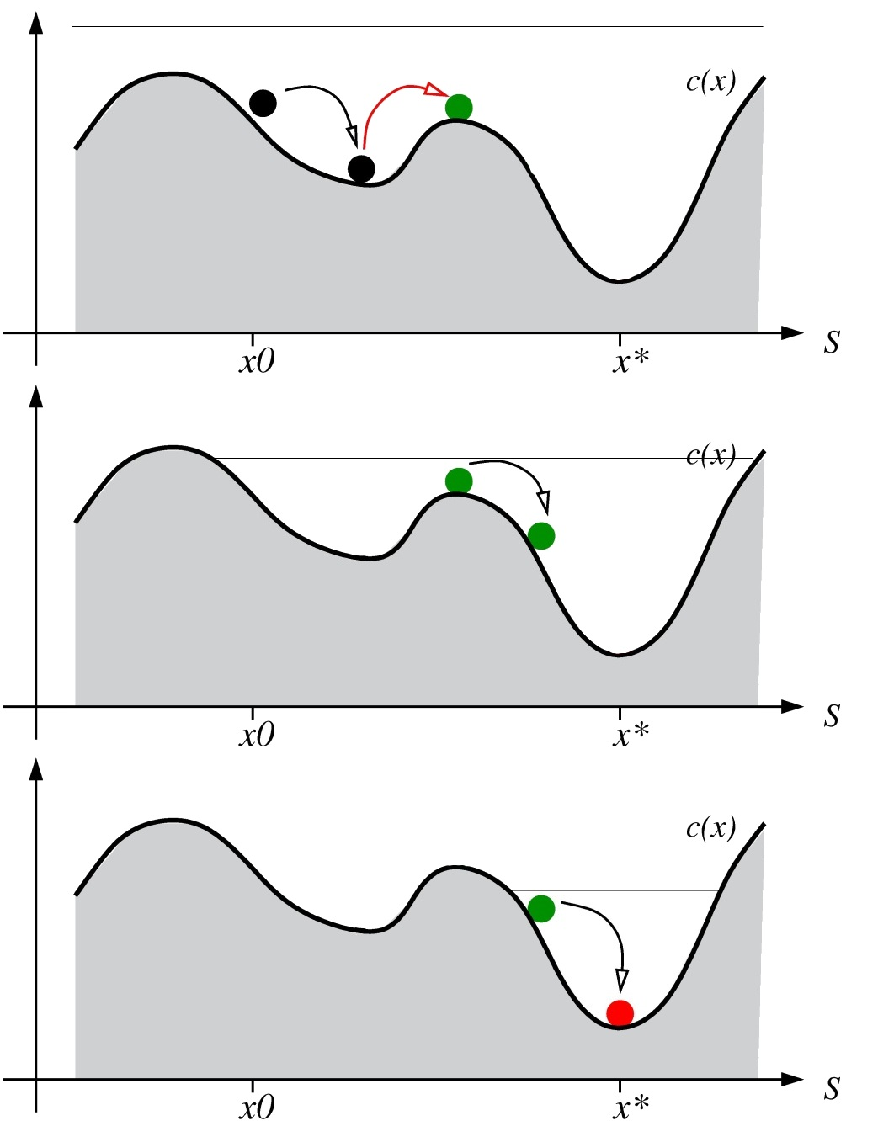
Simulated Annealing

Slide 12
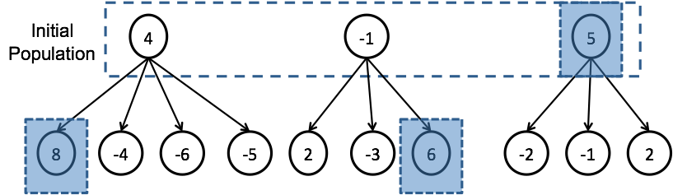
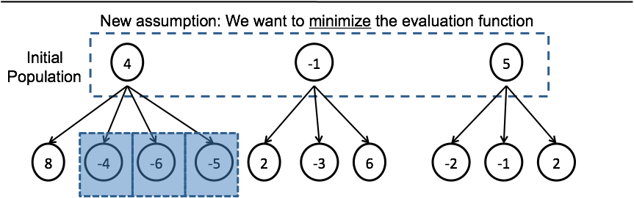
Local Beam Search

Slide 13
Genetic Algorithms

Slide 14
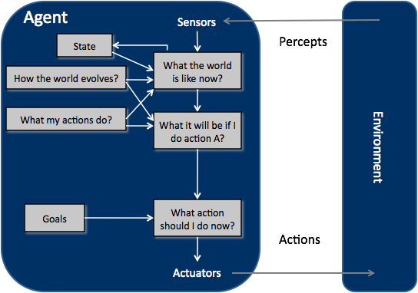
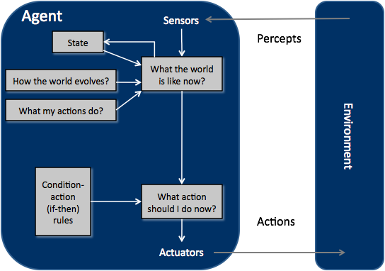
Search-based Problems
Search Problems
Given the state-space, a start state and a successor function
Find a goal state
Constraint Satisfaction Problems
Local Search
Classical Search
Uninformed
BFS
Uniform-First
DFS
Iterat.-Deep. DFS
Bidirectional
Hill-climbing
Hill-climbing with random restarts
Simulated Annealing
Local Beam Search
Genetic Algorithms
Informed
Best-First Search
Greedy BestFS
A*

Slide 15
Constraint- Satisfaction Problems
Discrete and Finite Domains
E.g., map-Coloring, 8-queens puzzle
Boolean CSPs
Satisfiability problems (prototypical NP-Complete problem)
Discrete and Infinite Domains
Scheduling over the set of integers (e.g., all the days after today)
Continuous Domains
Scheduling over continuous time
Linear Programming problems
Constraints are linear inequalities over the variables
Additional examples:
crossword puzzles, cryptography problems, Sudoku
and many classical NP-Complete problems:
clique problems, vertex-cover, traveling salesman, subset-sum, hamiltonian-cycle

Slide 16
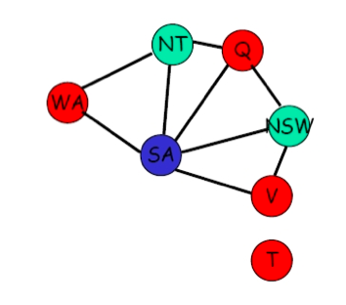

Example

Slide 17
Backtracking Search

Slide 18
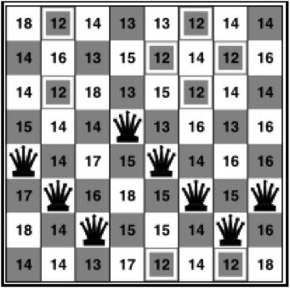

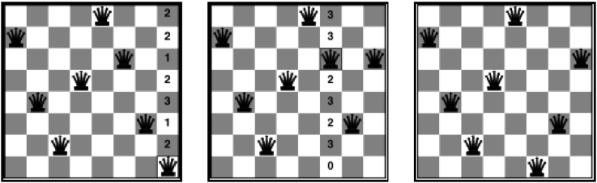
Local Search Approach

Slide 19
Backtracking: Forward Checking
 | WA | NT | Q | NSW | V | SA | T
Initially | RGB | RGB | RGB | RGB | RGB | RGB | RGB
After WA=R | R | G B | RGB | RGB | RGB | G B | RGB
After Q = G | R | B | G | R B | RGB | B | RGB
After V=B | R | B | G | R | B |  | RGB

Slide 20


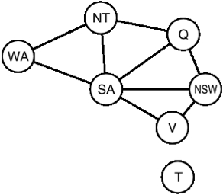



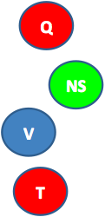

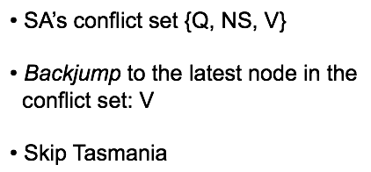
Backtracking: Intelligent Backjumping
Assume WA=red and NSW =red, then assign T, NT, Q, SA
SA will cause a conflict, whatever we do...
Where should the algorithm backjump?

